Slide 1
Numerical modelling of thermal radiation in fires
Soroush Rashidzadeh, Aalto University
April 29th , 2026

Slide 2
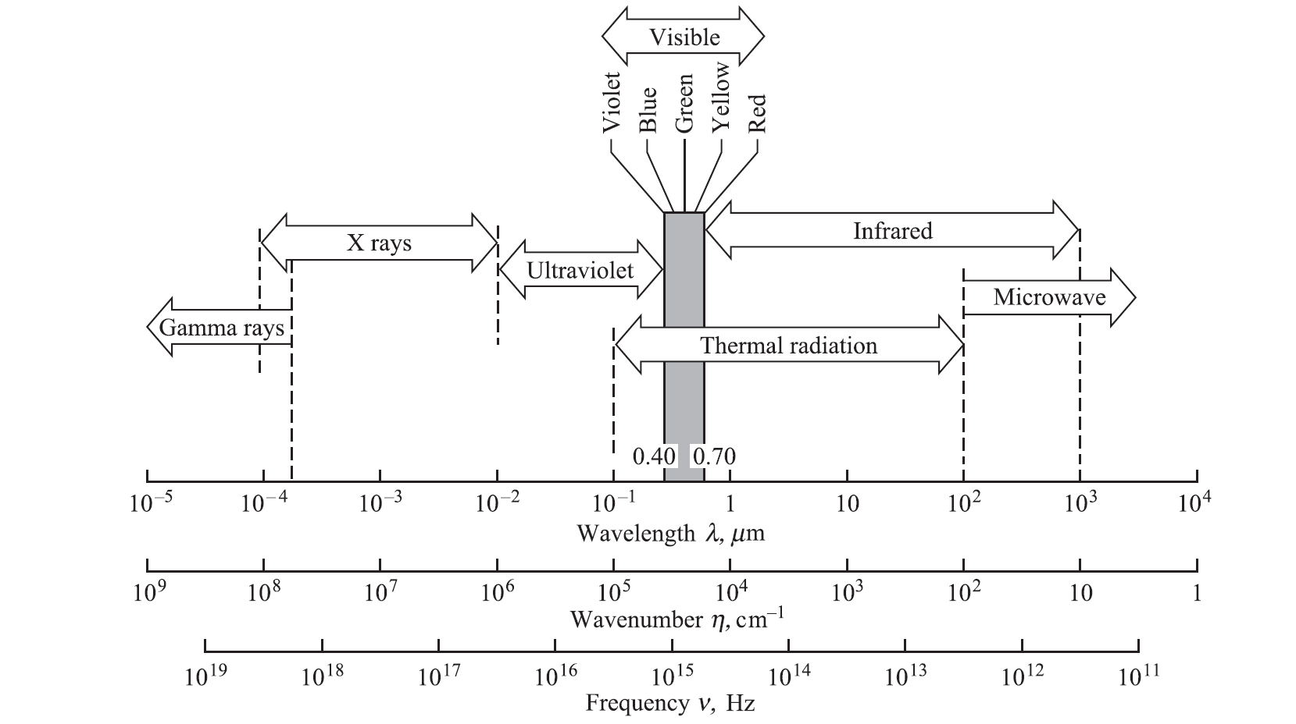
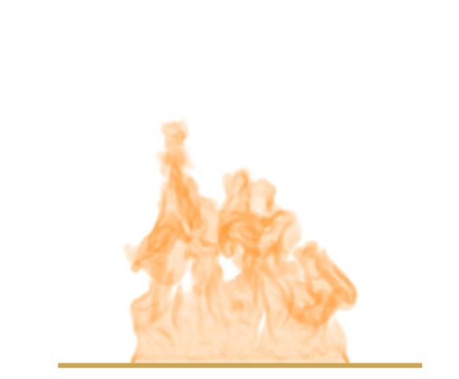
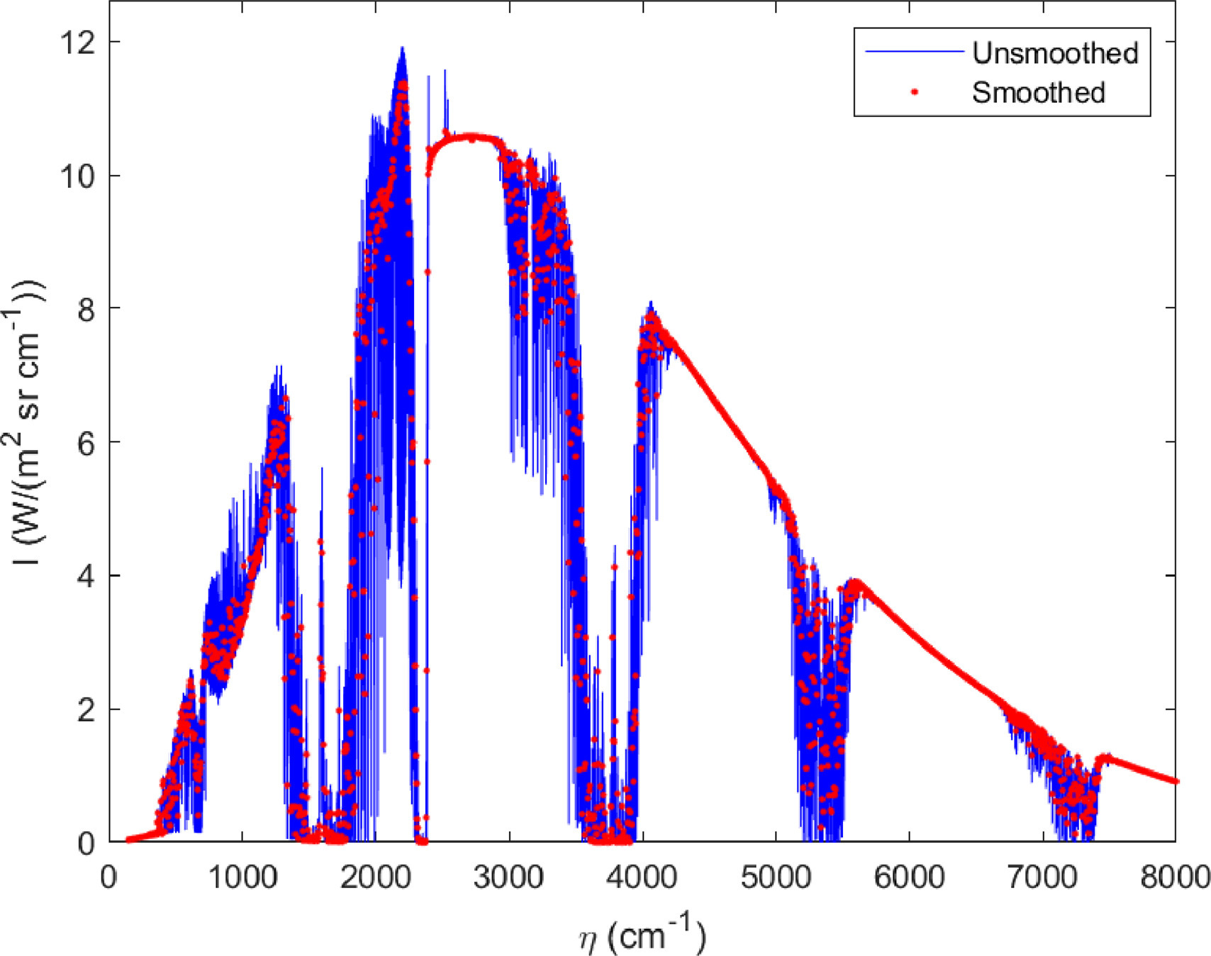

Introduction
Electromagnetic Spectrum:
Fire Dynamics Simulator (FDS)
CFD code for buoyant flames
Thermal radiation

Slide 3
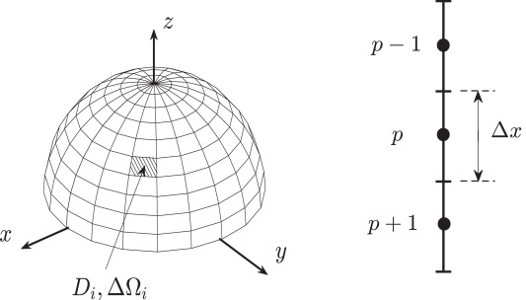

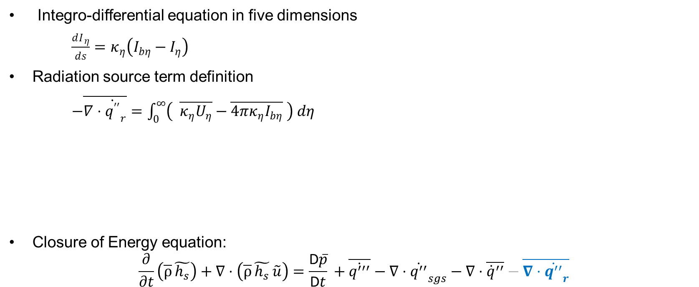
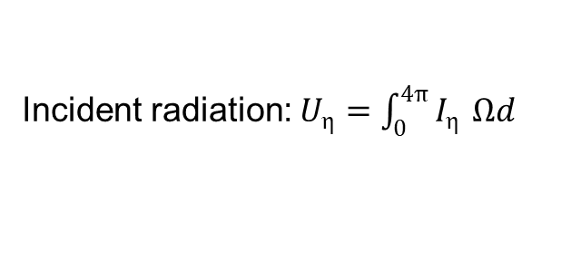
Radiative Transfer Equation
Integro-differential equation in five dimensions
$\frac{dI_{ η}}{ds}=κ_{η}\left(I_{bη}−I_{η}\right)$
Radiation source term definition
$−\overline{∇⋅{\dot{q^{′′}}}_{r}}=\int_{0}^{∞}{\left( \overline{κ_{η}U_{η}}−\overline{4πκ_{η}I_{bη}} \right) dη}$
Closure of Energy equation:
$$\frac{∂}{∂t}\left(\overline{ρ} \tilde{h_{s}}\right)+∇⋅\left(\overline{ρ} \tilde{h_{s}} \tilde{u}\right)=\frac{\text{D}\overline{p}}{\text{D}t} +\overline{\dot{q^{′′′}}}−∇⋅{\dot{q^{′′}}}_{sgs}−∇⋅\overline{{\dot{q}}^{′′}}−\overline{∇⋅{\dot{q^{′′}}}_{r}}$$
absorption
emission
Incident radiation: $U_{η}=\int_{0}^{4π}{I_{η}} Ωd$
Incident radiation: $U_{η}=\int_{0}^{4π}{I_{η}} Ωd$
3

Slide 4
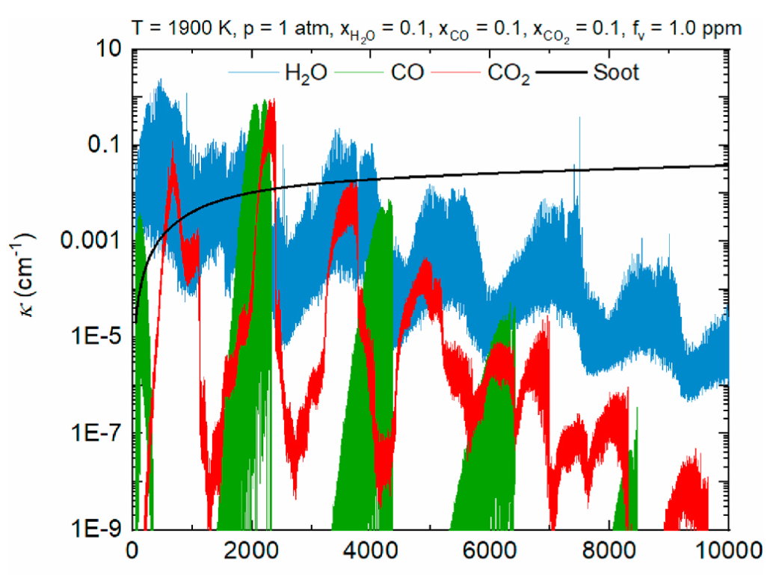
Treatment of spectral nature of RTE
Line-By-Line (LBL) calculation (Benchmark) [Millions of RTE]
Gray calculation [1 RTE] (general CFD modeling including FDS)
Non gray calculation (global models) [3-50 RTE]
  weighted sum of gray gases (WSGG)
  Spectral line based WSGG (RC-SLW)
  Full spectrum correlated k-distribution (RC-FSCK)
1
2
3
A
B
C
4

Slide 5
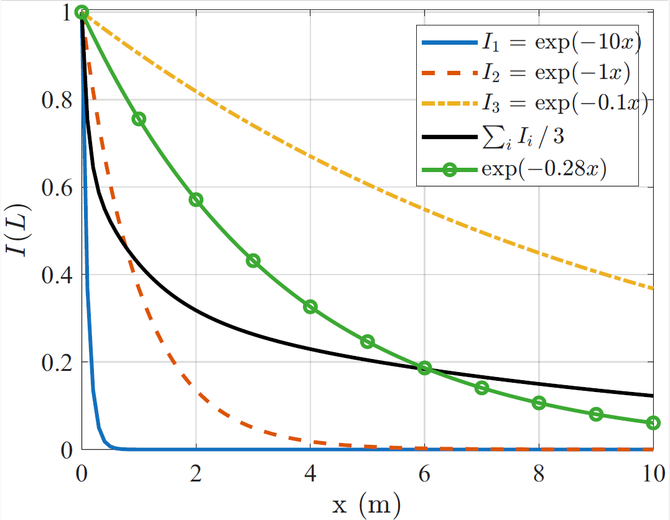
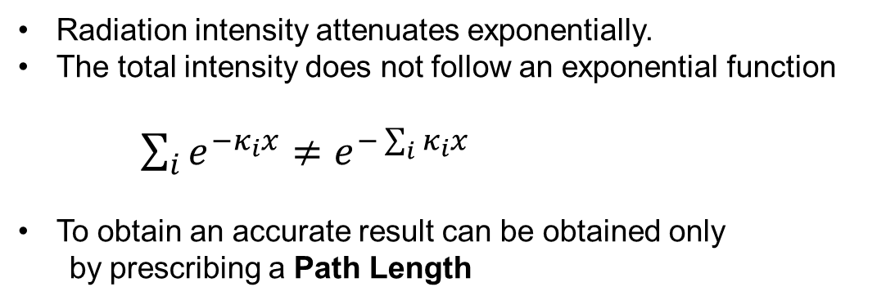
Problem with Gray approximation
Radiation intensity attenuates exponentially.
The total intensity does not follow an exponential function
$\sum_{i}^{ }{e^{−κ_{i}x}≠e^{−\sum_{i}^{ }{κ_{i}}x}}$
To obtain an accurate result can be obtained only
by prescribing a Path Length
5

Slide 6
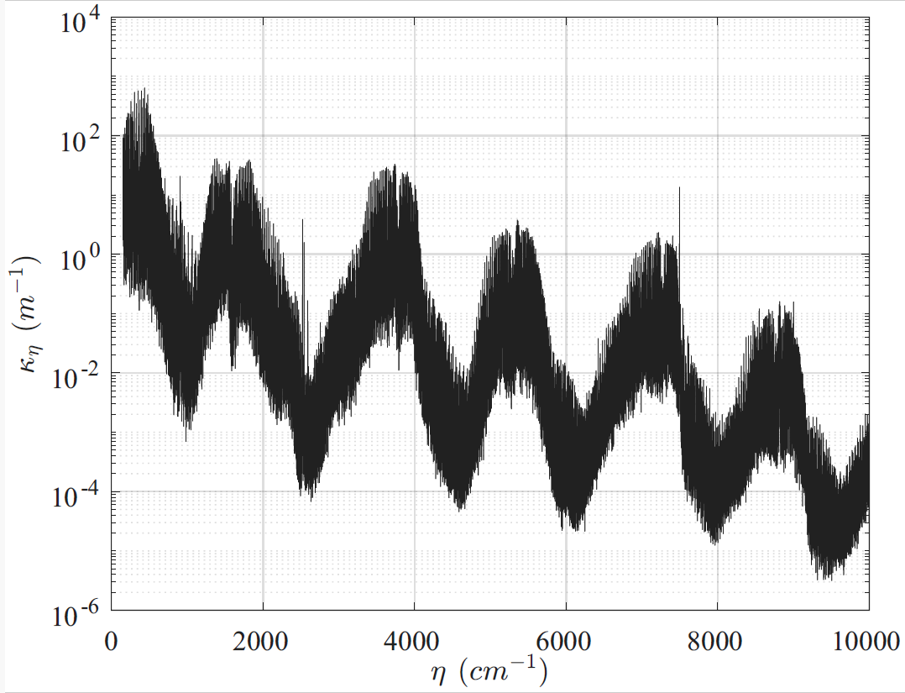
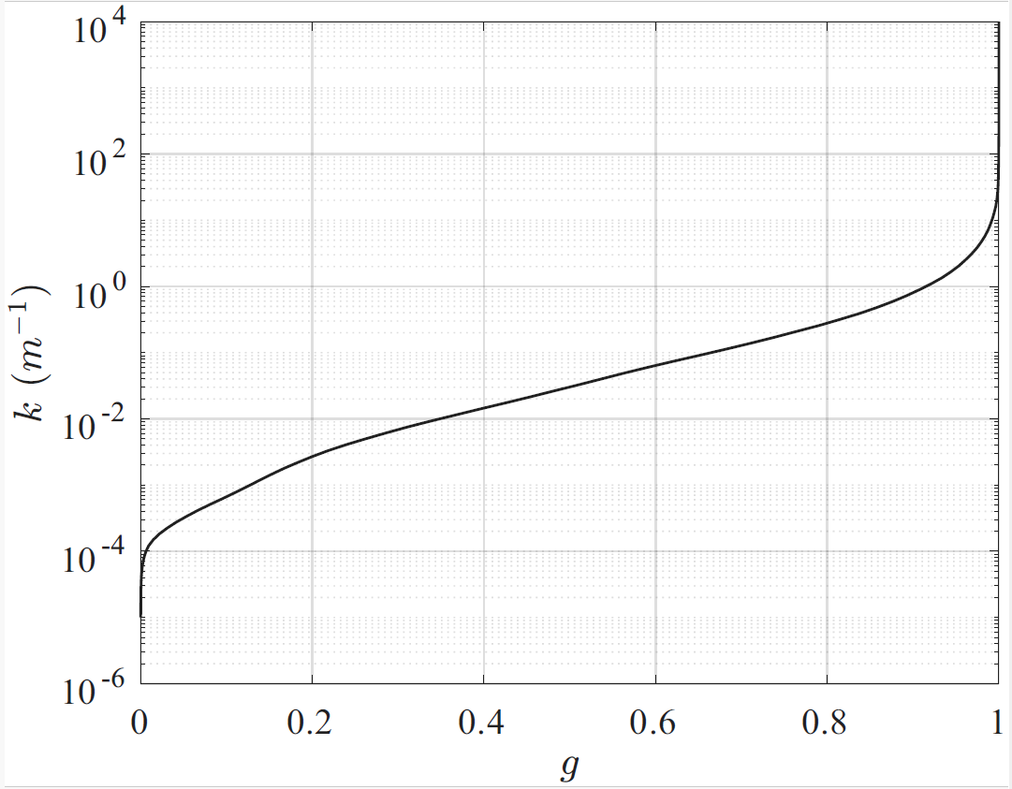


Development of an efficient global non-gray radiation model
(WSGG, RC-FSK, RC-SLW)
$$\frac{dI_{ η}}{ds}=κ_{η}\left(I_{bη}−I_{η}\right)$$
RC-FSK model
$$\frac{dI_{g}}{ds}=κ_{ }\left(a . I_{b}−I_{g}\right)$$
Millions of lines (LBL benchmark method)
Limited number of points (RC-FSK, RC-SLW)
K-distribution curve

Slide 7


Slide 8
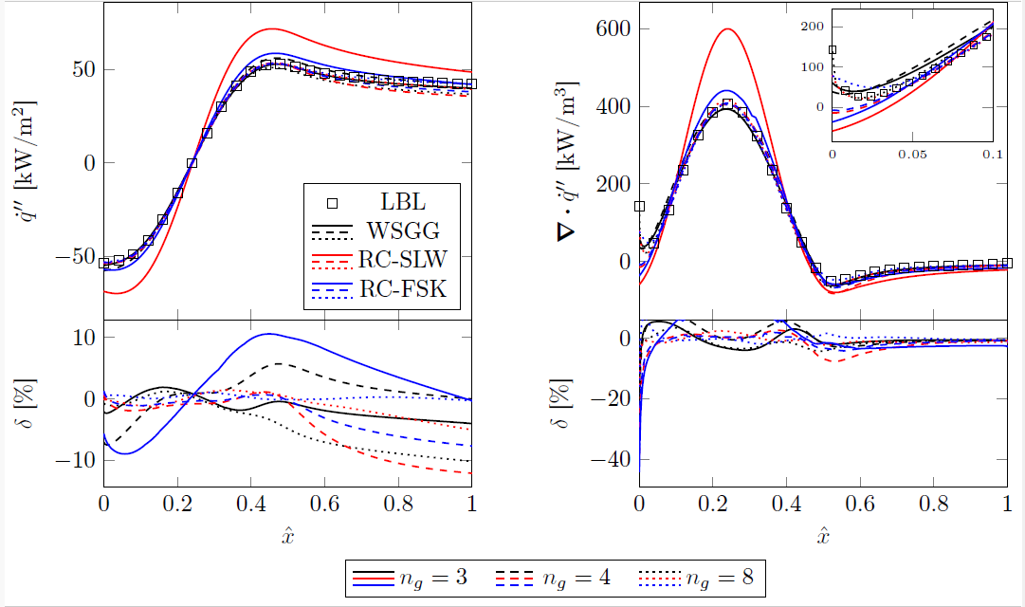
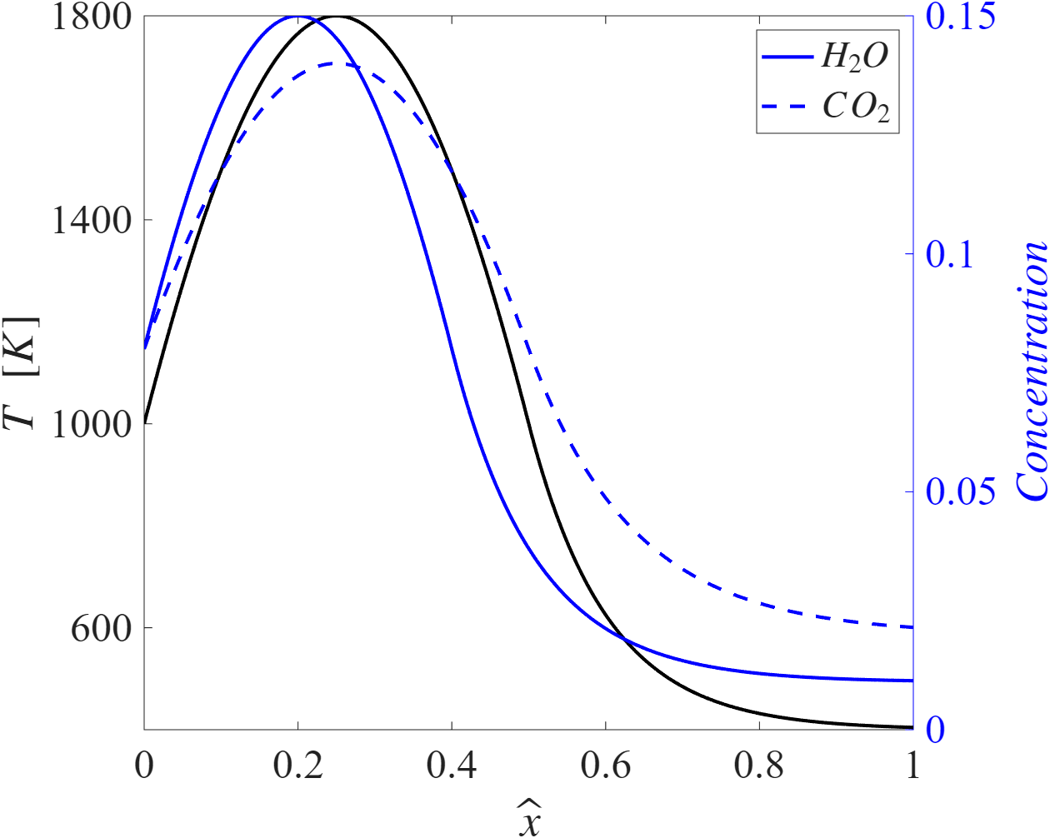
Results of global non-gray radiation models in 1D configuration

Slide 9
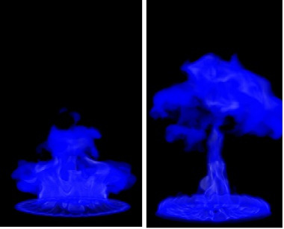
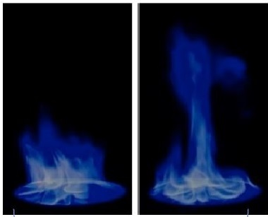
Integration of selected radiation model in FDS
Validation of the Methanol pool fire
Decoupled Calculation:
Using snapshot method to compare radiation models with benchmark (PMC-LBL)
Coupled Calculation:
CFD simulation (RC-FSK +TRI)
NIST Methanol pool fire (30 cm)

Slide 10
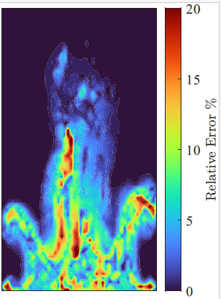
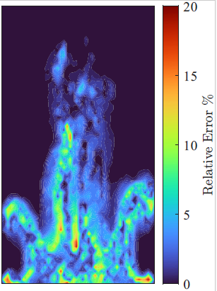
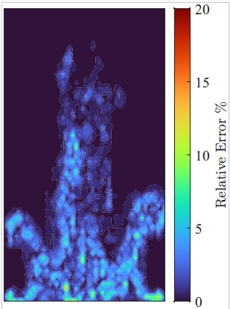
Validation of the Methanol pool fire
Decoupled calculation
RadCal (gray)
FDS default
RC-FSK
(ng=4)
RC-FSK
(ng=6)
Relative Error of radiation source term compared to benchmark PMC-LBL

Slide 11
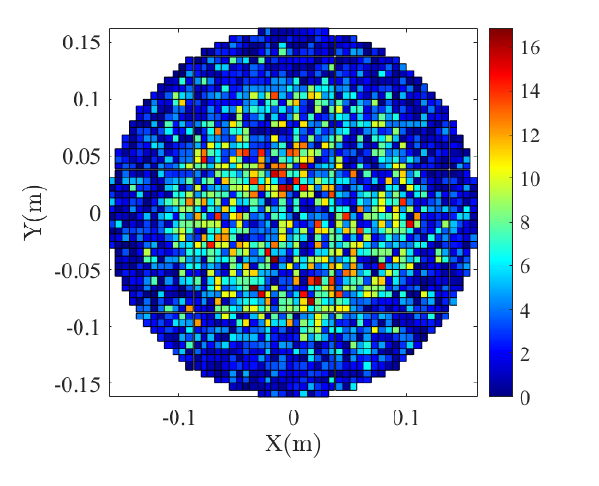
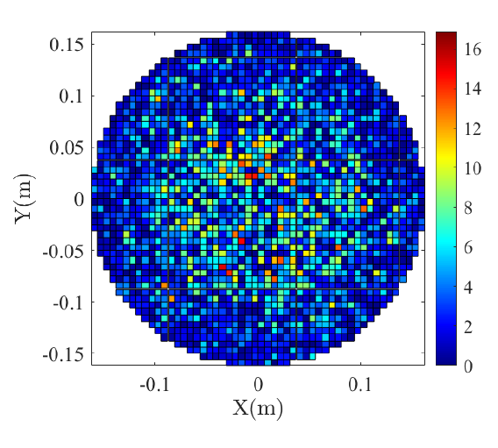
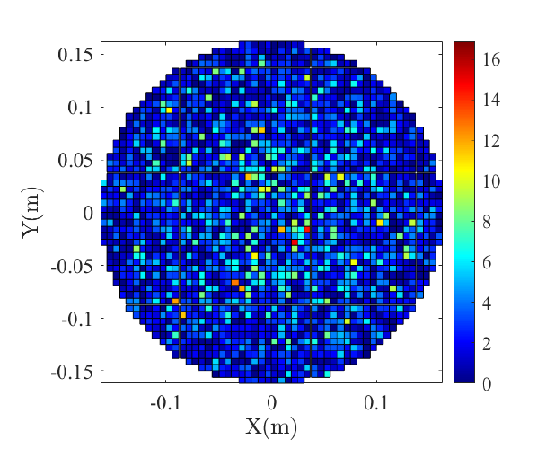
Validation of the Methanol pool fire
Decoupled calculation
RadCal (gray)
FDS default
RC-FSK
(ng=4)
RC-FSK
(ng=6)
Relative Error of radiation heat flux compared to benchmark PMC-LBL

Slide 12
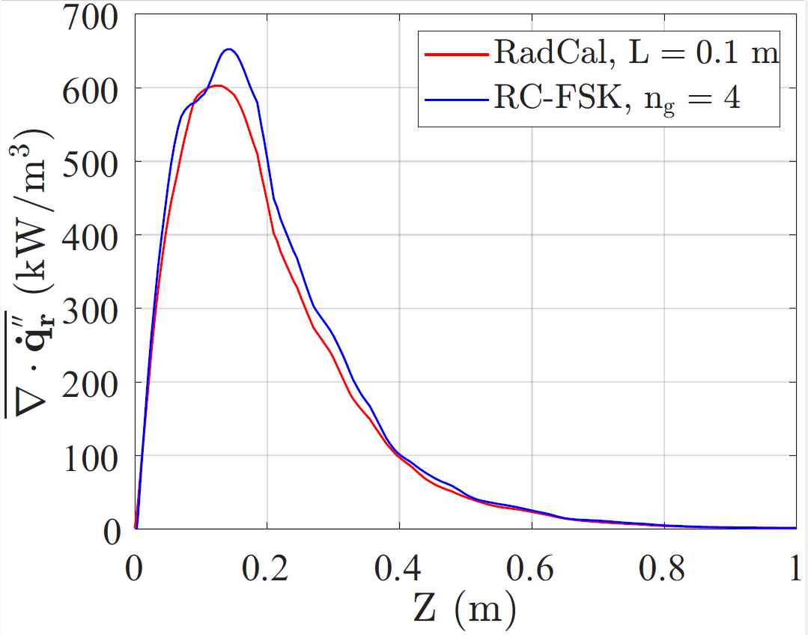
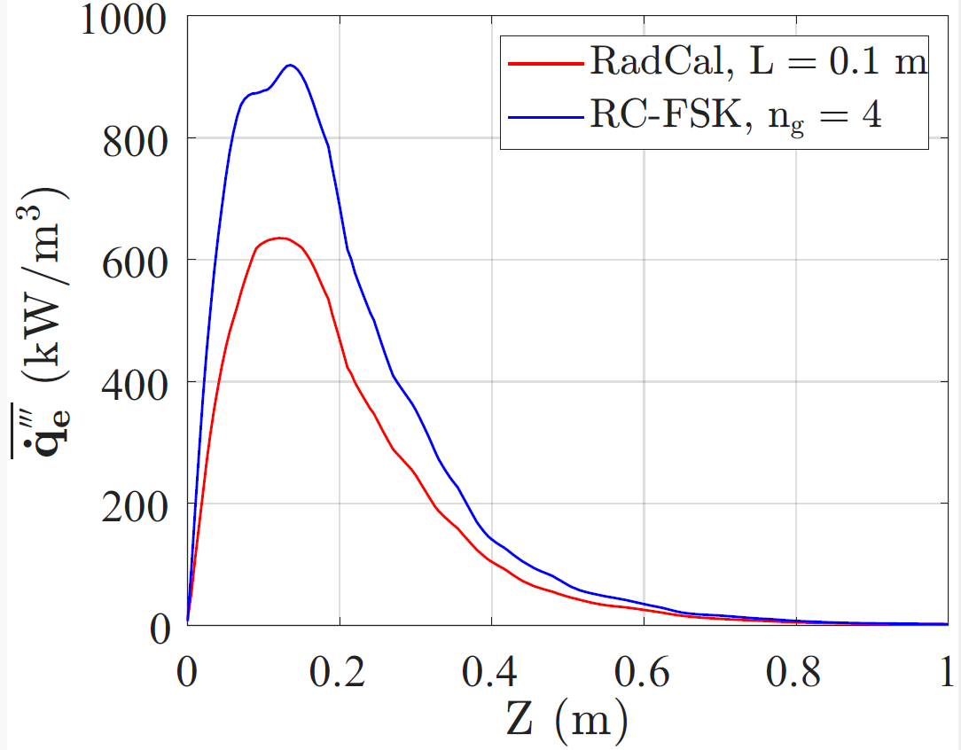
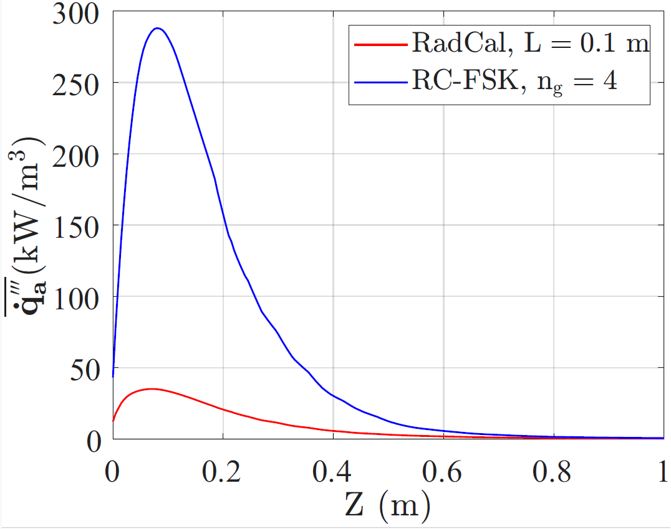
Validation of the Methanol pool fire
Coupled calculation
Radiation source term
Radiation emission
Radiation absorption
Centerline radiative quantities

Slide 13
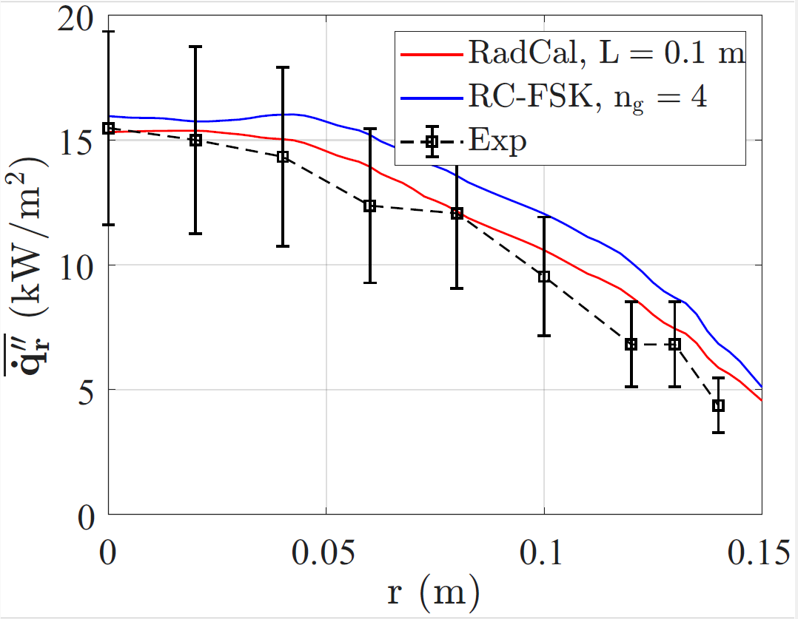
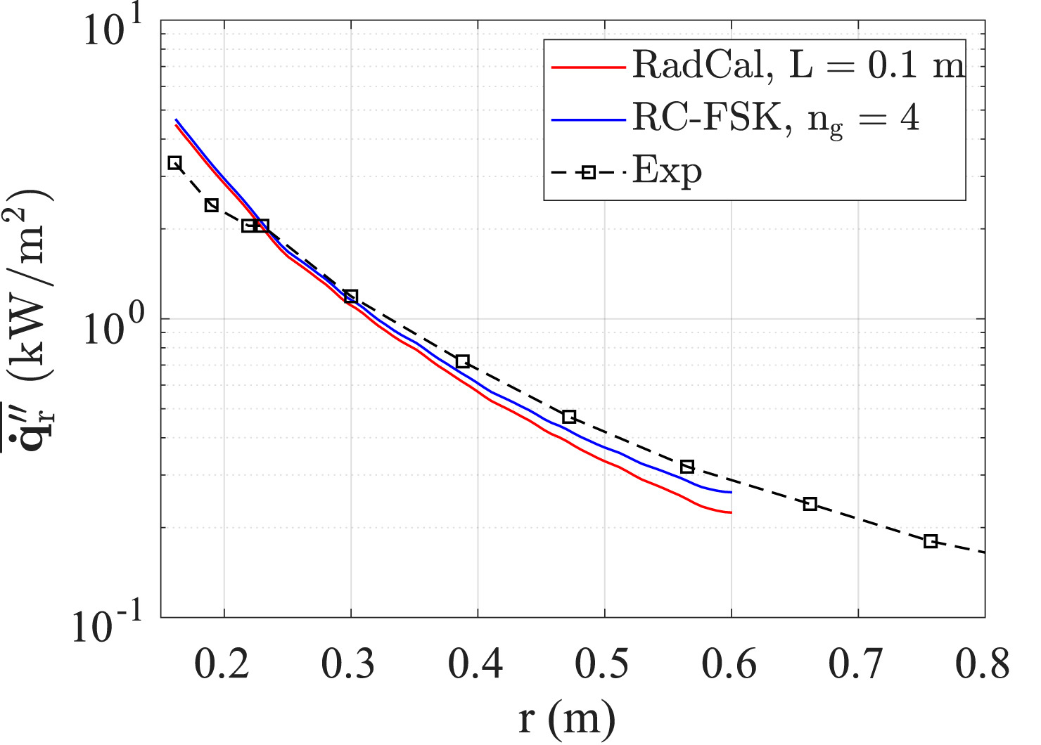
Validation of the Methanol pool fire
Coupled calculation
Radiative feedback to pool surface
Radiative flux away from pool
Radiative fluxes

Slide 14
Concluding remarks
Radiative heat transfer is the dominant mode of heat transfer in fires and boyant flames
Solving the RTE is challenging due to its dependency to spectrum
Gray approximation for absorption coefficient is acceptable with the definition of a proper path length
In problems with multiple characteristic length scales this can problematic
RC-FSK is a non-gray radiation model that provides more accurate predictions and does not rely on path length

